Slide 1
COSE472(00): Information Retrieval (정보검색) Lecture 3. Basics of Web Search II
Instructor: Jaegul Choo (주재걸)
jchoo@korea.ac.kr

Slide 2
Porter’s Stemmer
Sec. 2.2.4
The most common algorithm for stemming English
Typical rules
sses → ss
ies → i
ational → ate
tional → tion
Weight of word sensitive rules
(m>1) EMENT →
replacement → replac
cement → cement

Slide 3
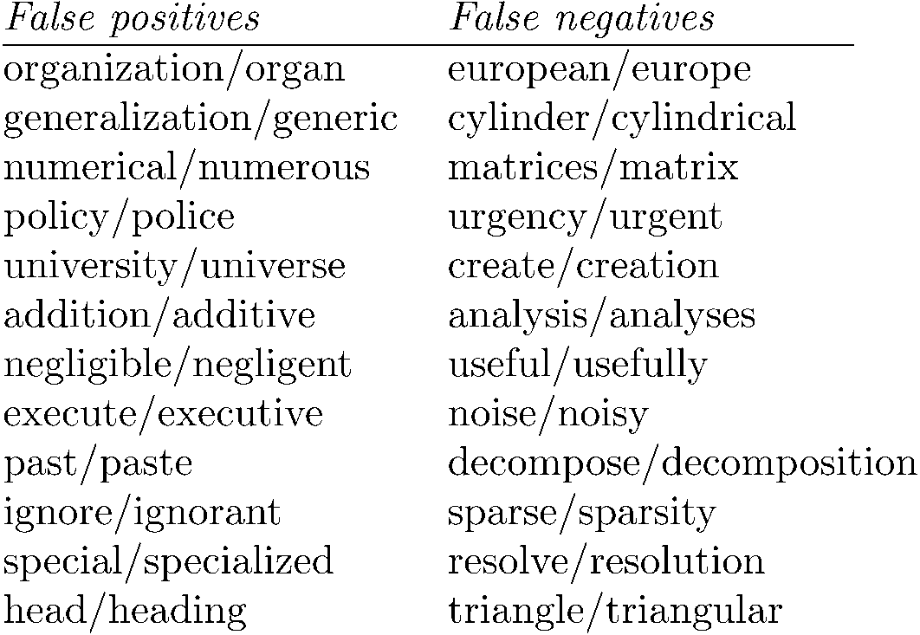
Examples of Porter Stemmer
False positives: Incorrectly produced pairs of words that have the same stem. (잘못하여 다른 단어를 같게)
False negatives: Pairs of words with the same stems, but are incorrectly stemmed into different stems. (잘못하여 같은 단어를 다르게)
Notes:
Can be viewed as a table.

Slide 4
Other stemmers
Sec. 2.2.4
Other stemmers exist:
Lovins stemmer
http://www.comp.lancs.ac.uk/computing/research/stemming/general/lovins.htm
Single-pass, longest suffix removal (about 250 rules)
Paice/Husk stemmer
Snowball
Notes:
careses
parties
separational -> separate
factional -> faction

Slide 5
Summary So Far
Term-document incidence matrix
Inverted index
“Merge” algorithm for processing Boolean queries
Phrase queries
Biword indexing
Positional indexing
Inverted index construction
Tokenization
Normalization
Stop words
Stemming
Further reading: “An Introduction to Information Retrieval”, or IIR, Chapter 1, 2
Notes:
Can be viewed as a table.

Slide 6
Problem of Boolean Queries
So far, our queries have all been Boolean.
What is the problem of this model?
Notes:
Can be viewed as a table.

Slide 7
Ranked Retrieval Models
Ranking of the documents is important.
We wish to return in order the documents most likely to be useful/relevant to the searcher.
Rather than a set of documents satisfying a query expression, in ranked retrieval, the system returns an ordering of the retrieved documents in the collection for a query
Main idea: Let’s put a higher rank on those documents containing more query terms.
-> Bag-of-words model or term-document matrix
Notes:
Can be viewed as a table.

Slide 8
Recall: (Binary) Term-Document Incidence Matrix
Sec. 6.2
Each document is represented by a binary vector ∈ {0,1}^{|V|}

Slide 9
Now, Term-Document (COUNT) Matrix
Sec. 6.2
Consider the number of occurrences of a term in a document
Each document is a count vector in V-dimensional space: a column vector shown below, where V is the dictionary size.

Slide 10
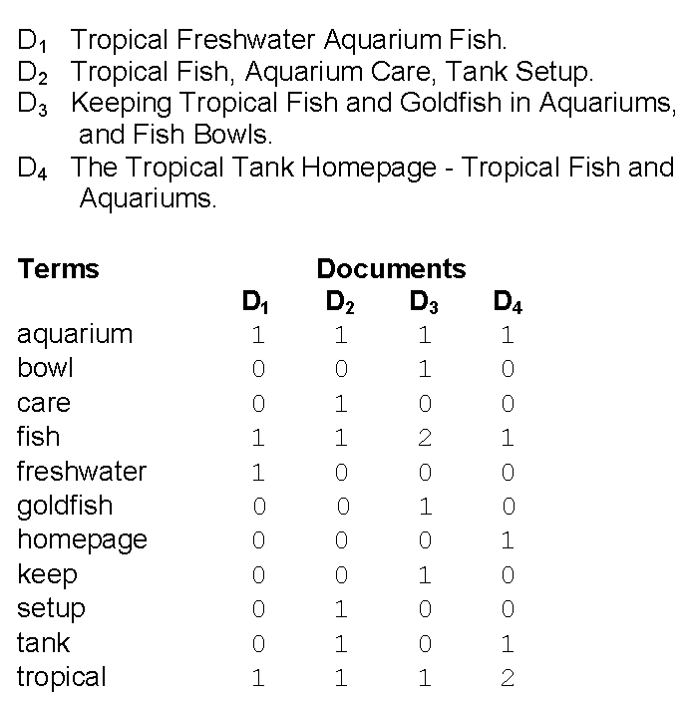
Another Example of Term-Document Matrix
Sec. 6.2

Slide 11
Bag-of-Words Model
Sec. 6.2
The (column) vector representation of each document in a term-document matrix is called a bag-of-words model.
John is quicker than Mary and Mary is quicker than John have the same vector representations.
In a sense, this is a step back: The positional index was able to distinguish these two documents, but the bag-of-words model does not.
Consider the number of occurrences of a term in a document
Each document is a count vector in V-dimensional space: a column below, where V is the dictionary size.

Slide 12
Term Frequency: tf
The term frequency tf_{t,d} of term t in document d is defined as the number of times that t occurs in d.
We want to use tf when computing query-document match scores.
We put a higher rankings on documents containing a larger tf of query words.
However, the raw term frequency is not what we want:
A document with 10 occurrences of the term is more relevant than a document with 1 occurrence of the term.
But not 10 times more relevant.
Relevance does not increase proportionally with term frequency.
Notes:
Can be viewed as a table.

Slide 13
Log-Frequency Weighting on tf
The log frequency weight w_{t,d} of term t in d is
0 → 0, 1 → 1, 2 → 1.3, 10 → 2, 1000 → 4, etc.
Score for a document-query pair: sum over terms t in both q and d:
score
The score is 0 if none of the query terms is present in the document.
Notes:
Can be viewed as a table.

Slide 14
Another Issue of Term Frequency
Log-frequency weighting handles the issue of the frequency not being proportional to the relevance within a single term.
How about the relevance between different terms?
e.g., Which of these tells you more about a document?
Suppose our query is “handsome person”
10 occurrences of “handsome”?
10 occurrences of “person”?
Would like to attenuate the weights of common terms
But what is "common"?
Notes:
Can be viewed as a table.

Slide 15
Document Frequency
Rare terms are more informative than frequent terms
Recall stop words
Let’s put more weights on rare terms.
e.g., “handsome” is rarer than “person”.
df_{t} (the document frequency of the term t): the number of documents that contain t
df_{t} is an inverse measure of the informativeness of t
df_{t} ≤ N (total number of documents)
Notes:
Can be viewed as a table.

Slide 16
Inverse Document Frequency (idf)
idf_{t} (the inverse document frequency of the term t):
Measure of informativeness of a term: its rarity across the whole corpus (많은 문서가 그 색인어를 가지고 있을수록, 그 색인어는 문서를 구분하는 변별력이 떨어진다.)
A simple definition could be idf_{t} = 1 / df_{t}
However, the most commonly used definition is:
idf_{t} = log₁₀ ( N / df_{t} ) where N is the total number of documents.
Why logarithm?
idf_{t} values will have more differences for small df_{t} values compared to large df_{t} values. However, such differences will become small as df_{t} gets bigger.
적은 df_{t} 값의 차이가 idf_{t} 값에서 확실하게 차이가 나도록, 그러나 df_{t} 값이 어느 정도 커지면 적은 df_{t} 값의 차이는 별로 idf_{t} 값이 차이가 나지 않도록.
Notes:
Can be viewed as a table.

Slide 17
Effect of idf on Ranking
Does idf have an effect on ranking for one-term queries?
e.g., the query “iPhone”
idf has no effect on ranking one term queries
idf affects the ranking of documents for queries with at least two terms
For the query “handsome person”, idf weighting makes occurrences of handsome count for much more in the final document ranking than occurrences of person.
Notes:
Can be viewed as a table.

Slide 18
tf-idf Weighting
The tf-idf weight of a term is the product of its tf weight and its idf weight.
Best known weighting scheme in information retrieval
Note: the “-” in tf-idf is a hyphen, not a minus sign!
Alternative names: tf.idf, tf x idf
Increases with the number of occurrences within a document
Increases with the rarity of the term in the collection
Notes:
Can be viewed as a table.

Slide 19
Score for a Document given a Query
There are many variants
How “tf” is computed (with/without logs)
Whether the terms in the query are also weighted
…
Notes:
Can be viewed as a table.

Slide 20
Binary → Count → Weight Matrix
Sec. 6.3
Each document is now represented by a real-valued vector of tf-idf weights ∈ R^{|V|}

Slide 21
Documents as Vectors
Sec. 6.3
So we have a |V|-dimensional vector space
Terms are axes of the space
Documents are points or vectors in this space
Very high-dimensional: tens of millions of dimensions when you apply this to a web search engine
These are very sparse vectors - most entries are zero.

Slide 22
Queries as Vectors
Sec. 6.3
Key idea 1: Do the same for queries: represent them as vectors in the space
Key idea 2: Rank documents according to their proximity to the query in this space
proximity = similarity of vectors
proximity ≈ inverse of distance
Recall: We do this because we want to get away from the “you’re-either-in-or-out” Boolean model.
Instead: rank more relevant documents higher than less relevant documents

Slide 23
Formalizing Vector Space Proximity
Sec. 6.3
First approach: distance between two points
( = distance between the end points of the two vectors)
Euclidean distance?
Euclidean distance is a bad idea . . .
. . . because Euclidean distance is large for vectors of different lengths.

Slide 24
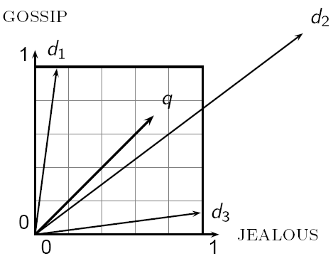
Why Distance is a Bad Idea
Sec. 6.3
The Euclidean distance between q
and d₂ is large even though the
distribution of terms in the query q and the distribution of
terms in the document d₂ are
very similar.

Slide 25
Use Angle instead of Distance
Sec. 6.3
Thought experiment: take a document d and append it to itself. Call this document d′.
“Semantically” d and d′ have the same content
The Euclidean distance between the two documents can be quite large.
The angle between the two documents is 0, corresponding to maximal similarity.
Key idea: Rank documents according to angle with query.

Slide 26
From Angles to Cosines
Sec. 6.3
The following two notions are equivalent.
Rank documents in decreasing order of the angle between query and document
Rank documents in increasing order of cosine(query, document)
Cosine is a monotonically decreasing function in the interval [0º, 180º]

Slide 27
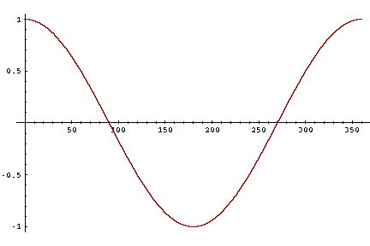
From Angles to Cosines
Sec. 6.3
But how – and why – should we be computing cosines?

Slide 28
Length Normalization
Sec. 6.3
A vector can be (length-) normalized by dividing each of its components by its length – for this we use the L₂ norm:
Dividing a vector by its L₂ norm makes it a unit (length) vector (on surface of unit hypersphere)
Effect on the two documents d and d′ (d appended to itself) from earlier slide: they have identical vectors after length-normalization.
Long and short documents now have comparable weights

Slide 29
Cosine (query, document)
Sec. 6.3
Dot product
Unit vectors
q_{i} is the tf-idf weight of term i in the query
d_{i} is the tf-idf weight of term i in the document
cos(q,d) is the cosine similarity of q and d … or,
equivalently, the cosine of the angle between q and d.
Notes:
See Law of Cosines (Cosine Rule) wikipedia page

Slide 30
Cosine for Length-Normalized Vectors
For length-normalized vectors, cosine similarity is simply the dot product (or scalar product):
for q, d length-normalized.

Slide 31
Cosine Similarity amongst 3 Documents
How similar are
the novels
SaS: Sense and
Sensibility
PaP: Pride and
Prejudice, and
WH: Wuthering
Heights?
term | SaS | PaP | WH
affection | 115 | 58 | 20
jealous | 10 | 7 | 11
gossip | 2 | 0 | 6
wuthering | 0 | 0 | 38
Term frequencies (counts)
Note: To simplify this example, we don’t do idf weighting.

Slide 32
Cosine Similarity amongst 3 Documents
Log-frequency weighting
After length-normalization
term | SaS | PaP | WH
affection | 3.06 | 2.76 | 2.30
jealous | 2.00 | 1.85 | 2.04
gossip | 1.30 | 0 | 1.78
wuthering | 0 | 0 | 2.58
term | SaS | PaP | WH
affection | 0.789 | 0.832 | 0.524
jealous | 0.515 | 0.555 | 0.465
gossip | 0.335 | 0 | 0.405
wuthering | 0 | 0 | 0.588
cos(SaS,PaP) ≈
0.789 × 0.832 + 0.515 × 0.555 + 0.335 × 0.0 + 0.0 × 0.0
≈ 0.94
cos(SaS,WH) ≈ 0.79
cos(PaP,WH) ≈ 0.69

Slide 33
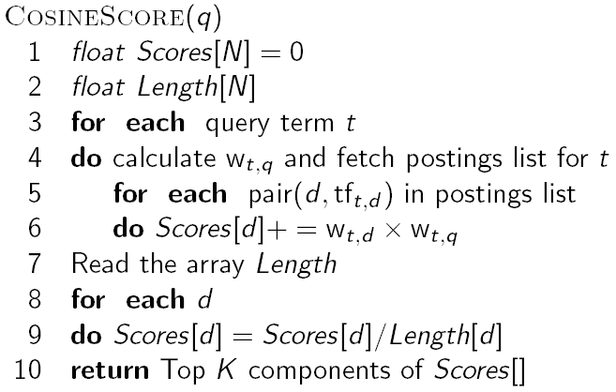
Computing Cosine Scores
Sec. 6.3

Slide 34
Summary – Vector Space Ranking
Represent the query as a weighted tf-idf vector
Represent each document as a weighted tf-idf vector
Compute the cosine similarity score for the query vector and each document vector
Rank documents with respect to the query by score
Return the top K (e.g., K = 10) to the user

Slide 35
Further Reading
“An Introduction to Information Retrieval”, or IIR, Chapter 6.2 – 6.4.3
Notes:
Can be viewed as a table.

